Slide 1
Software Quality

Slide 2
Software Quality
Software quality is the “Conformance to explicitly stated functional and performance requirements, explicitly documented development standards, and implicit characteristics that are expected of all professionally developed software”.

Slide 3
Software Quality
The above definition emphasizes three main points:
Software requirements are the foundation from which quality is measured. Lack of conformance to requirements is lack of quality.
Specified standards define a set of development criteria that provide guidance for the development of software.
Along with explicit requirements such as the desire for ease of use and good maintainability are also required.

Slide 4
Software Quality Attributes
Functionality: The capability to provide functions which meet specifications.
Reliability: The capability to maintain a specified level of performance under stated conditions.
Usability: The capability to be understood, learned, and used.
Efficiency: The capability to provide appropriate performance relative to the amount of resources used.
Maintainability: The capability to be modified for making corrections, enhancements or adaptation.
Portability: The capability to be adapted for different specified environments without applying actions or means other than those provided for this purpose in the product.

Slide 5
McCall’s Quality Factors
McCall, Richard, and Walters proposed a useful categorization of software quality factors.
This model attempts to bride the gap between users and developers by focusing on a number of software quality factor that reflect both the users view and developers priorities.
This model has three major perspectives for defining and identifying the quality of a software product:
Its operational characteristics
Its ability to undergo change
Its adaptability to new environments.

Slide 6
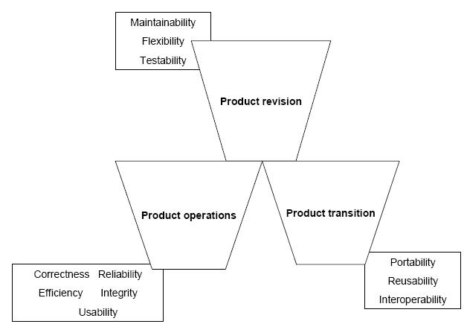
McCall’s Quality Factors

Slide 7
Product Operations : This identifies quality factors that influence the extent to which the software fulfils its specification.
Correctness : The extent to which a functionality matches its specification.
Reliability : The systems ability not to fail/ the extent to which the system fails.
Efficiency : Further categorized into execution efficiency and storage efficiency and generally means the usage of system resources, example: processor time, memory.
Integrity : The protection of program from unauthorized access.
Usability : The ease of using software.

Slide 8
Product Revision : This identifies quality factors that influence the ability to change the software product.
Maintainability : Effort required to locate and fix a fault in the program within its operating environment.
Flexibility : The ease of making changes required as dictated by business by changes in the operating environment.
Testability : The ease of testing program to ensure that it is error-free and meets its specification, i.e., validating the software requirements.

Slide 9
Product Transition : This identifies quality factors that influence the ability to adapt the software to new environments.
Portability : The effort required to transfer a program from one environment to another.
Re-usability : The ease of reusing software in a different context.
Interoperability: The effort required to couple the system to another system.

Slide 10
The model further details the three types of quality characteristics in a hierarchy of factors, criteria and metrics:
11 Factors(To specify): They describe the external view of the software, as viewed by the users.
23 quality criteria(To build): They describe the internal view of the software, as seen by the developer.
Metrics(To control): They are defined and used to provide a scale and method of measurement.

Slide 11
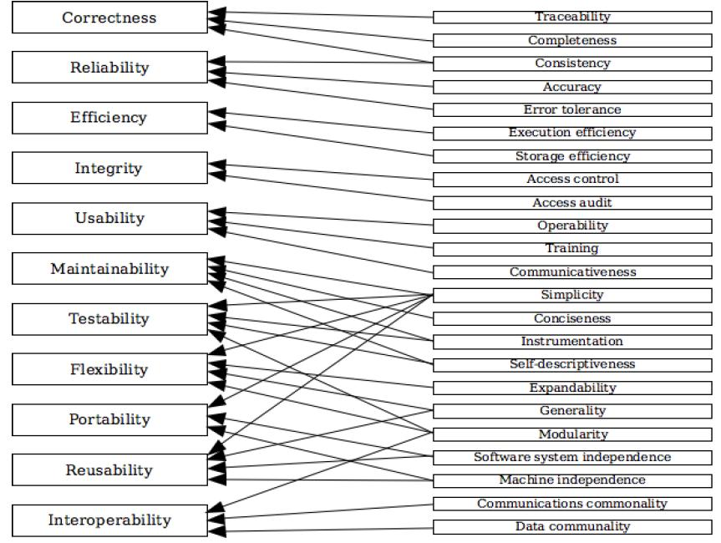

Slide 12
McCall’s Software Metrics
Auditability
Accuracy
Communication commonality
Completeness
Consistency
Data commonality
Error tolerance
Execution efficiency
Expandability
Generality
Hardware independence
Instrumentation
Modularity
Operability
Security
Self-documentation
Simplicity
Software system independence
Traceability
Training

Slide 13
Auditability: The ease with which conformance to standards can be checked
Accuracy: The precision of computations and control
Communication commonality: The degree to which standard interfaces, protocols and bandwidth are used
Completeness: The degree to which full implementation of the required function has been achieved
Conciseness: The compactness of the program in terms of lines of code
Consistency: The use of uniform design and documentation techniques throughout the software development protocol

Slide 14
Data commonality: The use of standard data structures and types throughout the program
Error tolerance: The damage that occurs when a program encounters an error
Execution efficiency: The run-time performance of the program
Expandability: The degree to which architectural, data or procedural design can be extended
Generality: The breadth of potential application of program components
Hardware independence: The degree to which the software is decoupled from the hardware on which it operates
Instrumentation: The degree to which the program monitors its own operations and identifies errors that do occur

Slide 15
Modularity: The functional independence of program components
Operability: The ease of operation of the program
Security: The availability of mechanisms that control or protect programs and data
Self-documentation: The degree to which the source code provides meaningful documentation
Simplicity: The degree to which a program can be understood without difficulty
Traceability: The ability to trace a design representation or actual program component back to requirements

Slide 16
Software system independence: The degree to which the program is independent of non-standard programming language features, operating system characteristics and other environmental constraints
Training: The degree to which the software assists in enabling new users to apply the system

Slide 17
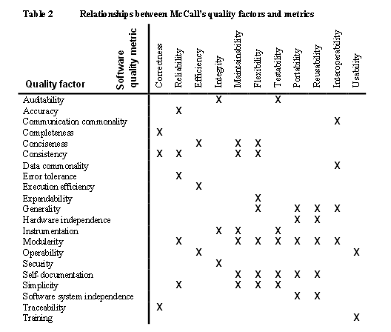

Slide 18
Boehm’s Quality Model(1978)
Boehm’s model is similar to the McCall Quality Model in that it also presents a hierarchical quality model structured around high-level characteristics, intermediate level characteristics, primitive characteristics – each of which contributes to the overall quality level.

Slide 19
The high-level characteristics represent basic high-level requirements of actual use to which evaluation of software quality could be put – the general utility of software.
The high-level characteristics address three main questions that a buyer of software has:
As-is utility : How well (easily, reliably, efficiently) can I use it as-is?
Maintainability: How easy is it to understand, modify and retest?
Portability : Can I still use it if I change my environment?

Slide 20
The intermediate level characteristic represents Boehm’s 7 quality factors that together represent the qualities expected from a software system:
Portability (General utility characteristics): Code possesses the characteristic portability to the extent that it can be operated easily and well on computer configurations other than its current one.
Reliability (As-is utility characteristics): Code possesses the characteristic reliability to the extent that it can be expected to perform its intended functions satisfactorily.
Efficiency (As-is utility characteristics): Code possesses the characteristic efficiency to the extent that it fulfils its purpose without waste of resources.
Usability (As-is utility characteristics, Human Engineering): Code possesses the characteristic usability to the extent that it is reliable, efficient and human-engineered.

Slide 21
Testability (Maintainability characteristics): Code possesses the characteristic testability to the extent that it facilitates the establishment of verification criteria and supports evaluation of its performance.
Understandability (Maintainability characteristics): Code possesses the characteristic understandability to the extent that its purpose is clear to the inspector.
Flexibility (Maintainability characteristics, Modifiability): Code possesses the characteristic modifiability to the extent that it facilitates the incorporation of changes, once the nature of the desired change has been determined.

Slide 22
The lowest level structure of the characteristics hierarchy in Boehm’s model is the primitive characteristics metrics hierarchy.
The primitive characteristics provide the foundation for defining qualities metrics – which was one of the goals when Boehm constructed his quality model.
Consequently, the model presents one more metrics supposedly measuring a given primitive characteristic.

Slide 23
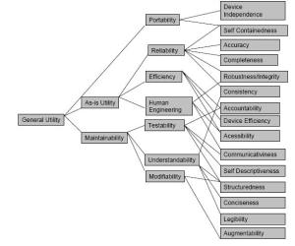

Slide 24
Though Boehm’s and McCall’s models might appear very similar, the difference is that McCall’s model primarily focuses on the precise measurement of the high-level characteristics “As-is utility”, whereas Boehm’s quality model is based on a wider range of characteristics with an extended and detailed focus on primarily maintainability.

Slide 25
FURPS
Usability
Functionality
Performance
FURPS+
Reliability
Supportability

Slide 26
The FURPS- categories are of two types: Functional(F) and Non-functional(URPS). These categories can be used as both product requirements as well as in the assessment of product quality.

Slide 27
FURPS/FURPS+
The characteristics that are taken into consideration in FURPS model are:
Functionality- includes feature sets, capabilities and security;
Usability -includes human factors, consistency in the user interface, online and context-sensitive help, wizards, user documentation, and training materials;

Slide 28
Reliability: includes frequency and severity of failure, recoverability, predictability, accuracy, and mean time between failure (MTBF).
Performance: prescribes conditions on functional requirements such as speed, efficiency, availability, accuracy, throughput, response time, recovery time, and resource usage.
Supportability: includes testability, extensibility, adaptability, maintainability, compatibility, Configurability, serviceability, install ability, and localizability / internationalization.

Slide 29
Dromey’s Quality Model
Dromey has built a quality evaluation framework that analyzes the quality of software components through the measurement of tangible quality properties.
Dromey gives the following examples of what he means by software components for each of the different models:
Variables, functions, statements, etc. can be considered components of the Implementation model.
A requirement can be considered a component of the requirements model.
A module can be considered a component of the design model.

Slide 30
According to Dromey, all these components possess intrinsic properties that can be classified into four categories:
Correctness : Evaluates if some basic principles are violated.
Internal : Measure how well a component has been deployed according to its intended use.
Contextual : Deals with the external influences by and on the use of a component.
Descriptive : Measure the descriptiveness of a component (for example, does it have a meaningful name.)

Slide 31
Dromey focuses on the relationship between the quality attributes and the sub-attributes, as well as attempts to connect software product properties with software quality attributes.
Product properties that influence quality.
High level quality attributes.
Means of linking the product properties with the quality attributes.

Slide 32
Dromey’s Quality Model is further structured around a 5 step process:
Choose a set of high-level quality attributes necessary for the evaluation.
List components/modules in your system.
Identify quality-carrying properties for the components/modules (qualities of the component that have the most impact on the product properties from the list above).
Determine how each property effects the quality attributes.
Evaluate the model and identify weaknesses.

Slide 33
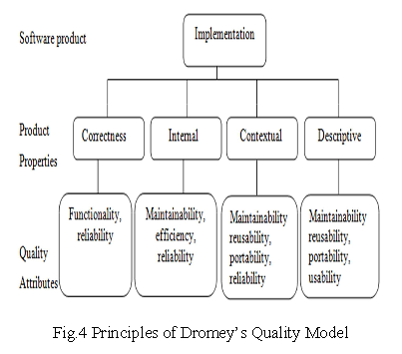

Slide 34
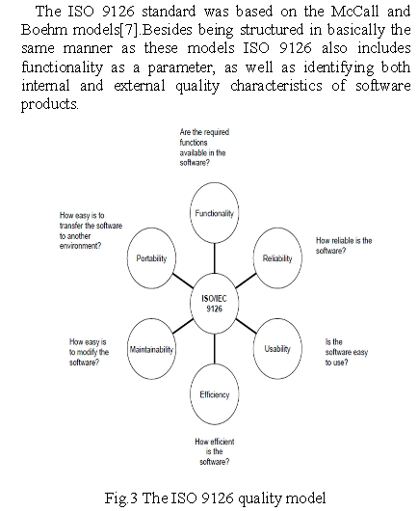
ISO 9126

Slide 35
ISO classifies software quality in a structured set of characteristics and sub-characteristics as follows:
Functionality : A set of attributes that bear on the existence of a set of functions and their specified properties. The functions are those that satisfy stated or implied needs.
Suitability
Accuracy
Interoperability
Security
Functionality Compliance
Reliability : A set of attributes that bear on the capability of software to maintain its level of performance under stated conditions for a stated period of time.
Maturity
Fault Tolerance
Recoverability
Reliability Compliance

Slide 36
Usability : A set of attributes that bear on the effort needed for use, and on the individual assessment of such use, by a stated or implied set of users.
Understandability
Learn ability
Operability
Attractiveness
Usability Compliance
Efficiency : A set of attributes that bear on the relationship between the level of performance of the software and the amount of resources used, under stated conditions.
Time Behaviour
Resource Utilization
Efficiency Compliance

Slide 37
Maintainability: A set of attributes that bear on the effort needed to make specified modifications.
Analyzability
Changeability
Stability
Testability
Maintainability Compliance
Portability: A set of attributes that bear on the ability of software to be transferred from one environment to another.
Adaptability
Installability
Co-Existence
Replaceability
Portability Compliance

Slide 38
